Slide 1




DESKTOP ASSISTANT
Shivam Deswal (211119)
PROGRAMMING ESSENTIALS - 18B11CI314- 18B11CI314 (2022-23)

Slide 2
ACKNOWLEDGEMENT
I would like to express my special thanks of gratitude to my teacher (Dr. Jagpreet Siddhu) who gave me the golden opportunity to do this project on the topic (DESKTOP ASSISTANT), which also helped me in doing a lot of Research and ,I came to know about so many new things I am really thankful to him .Secondly I would also like to thank my parents and friends who helped me a lot in finalizing this project within the limited time frame.

Slide 3
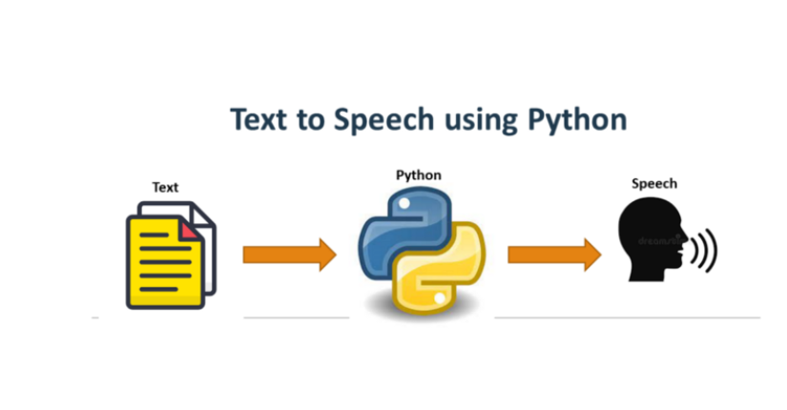
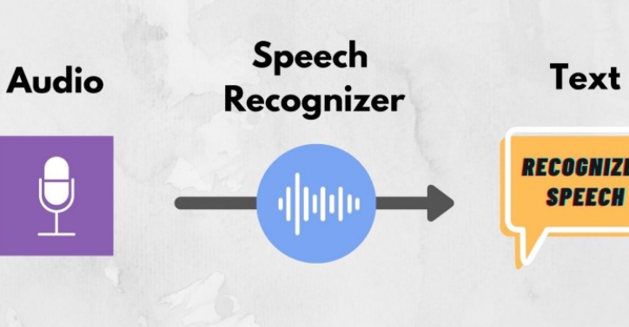

Modules Used
PYTTSX3
SPEECH RECOGNITION
WEBBROWSER
pyttsx3 is a text-to-speech conversion library in Python.
You can then use speech recognition in Python to convert the spoken words into text, make a query or give a reply.
The webbrowser module provides a high-level interface to allow displaying web-based documents to users

Slide 4



Modules Used
DATE TIME
OS
WIKIPEDIA
Python Datetime module supplies classes to work with date and time. These classes provide a number of functions to deal with dates, times and time intervals.
Python OS module provides the facility to establish the interaction between the user and the operating system.
Wikipedia is a Python library that makes it easy to access and parse data from Wikipedia

Slide 5

REFERENCES
www.geeksforgeeks.org
www.stackoverflow.com
https://docs.python.org

Slide 6
SOURCE CODE
# 211119 and 211102
#Shivam Deswal Aayush Sharma
#Desktop Assistant
#Importing Modules
import wikipedia
import webbrowser
import os
import pyttsx3
import speech_recognition as sr
import datetimE

Slide 7
#sapi5 to take voice from user depending on your system it is an api
engine = pyttsx3.init('sapi5')
voices = engine.getProperty('voices')
engine.setProperty('voice', voices[0].id)
def speak(audio):
'''This Function is used to take string and convert that into voice'''
engine.say(audio)
engine.runAndWait()
def greet():
'''This function wish user according to time'''
speak("Hello Sir")
speak("I'm Thor , God of thunder. What I'm suppose to do")

Slide 8
def takeVoiceinput():
'''It takes microphone input from the user and returns string output'''
r = sr.Recognizer()
with sr.Microphone() as source:
print("Try Saying...")
r.pause_threshold = 1 #Seconds of non-speaking audio before a phrase is considered complete
audio = r.listen(source)
try:
print("Recognizing...")
voice = r.recognize_google(audio, language='en-in')
print(f"User said: {voice}\n")
except Exception as e:
print("Repeat again ..")
return "None"
return voice

Slide 9
if __name__ == "__main__":
greet()
while True:
voice String = takeVoiceinput().lower()
if 'wikipedia' in voice String:
speak('Searching Wikipedia...')
voice String = voice String.replace("wikipedia", "")
results = wikipedia.summary(voice String, sentences=1)
speak("According to Wikipedia")
print(results)
speak(results)
# For Web Search
elif 'open spotify' in voice String:
webbrowser.open("spotify.com") #open spotify elif 'open youtube' in voice String:
webbrowser.open("youtube.com") #open youtube elif 'open google' in voice String:
webbrowser.open("google.com")

Slide 10
elif 'open gmail' in voiceString:
webbrowser.open("gmail.com")n#open gmail
elif 'open instagram' in voiceString:
webbrowser.open("instagram.com") #open instagram
elif 'open facebook' in voiceString:
webbrowser.open("facebook.com") #open facebook
elif 'open flipkart' in voiceString:
webbrowser.open("flipkart.com") #open flipkart
#Play Favourite song
elif 'play music' in voiceString:
music_dir ='C:\\Users\\SHIVAM\\Music\\music'
songs = os.listdir(music_dir)
print(songs)
os.startfile(os.path.join(music_dir, songs[0]))

Slide 11
# Tell current date and time
elif 'the time' in voiceString:
strTime = datetime.datetime.now().strftime("%H:%M:%S")
speak(f"Current, time is {strTime}")
# Open vs code current
elif 'vs code' in voiceString:
vsCode = "C:\\Users\\SHIVAM\\AppData\\Local\\Programs\\Microsoft VS Code\\Code.exe"
os.startfile(vsCode)
#close or exit
elif 'thor sleep' in voiceString:
quit()

Slide 12
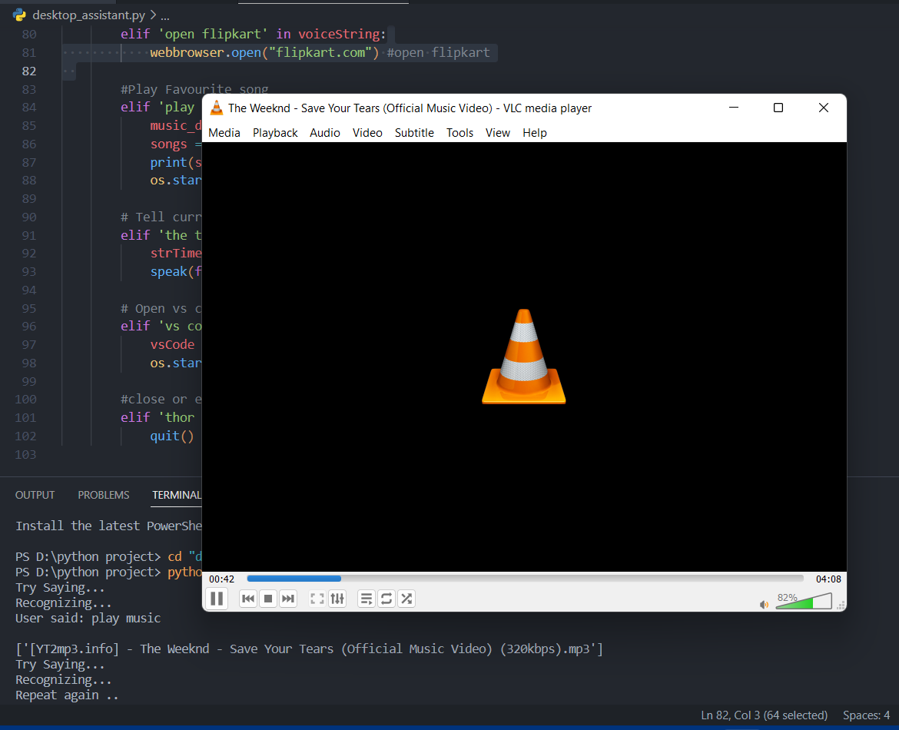
OUTPUT

Slide 13

THANK YOU

